Slide 1
Why your ERP is NOT delivering and how to fix IT
James A Robertson and Associates
Effective Strategic Business Solutions
3. Why do ERP implementations fail to deliver?
The Real Issues in World Class ERP and the Critical Factors for ERP Investment Success
Dr James Robertson PrEng
Copyright 2004 through 2013
James@JamesARobertson.com
Notes:
NB remember to have a chair to stand on
Make sure to take the CRITICAL FACTORS BOOK with you
An engineer with a PhD in engineering

Slide 2
Discussion
Why do ERP implementations FAIL to deliver
Notes:
DHL, Prochem,

Slide 3
Three alternative ERP value scenarios Unlocking the TRUE potential of ERP / IBIS 100 / 1,000 x the norm ???
1,000
XXX 10
This is the ONLY valid scenario but it seldom occurs
3. Strategic customization
With CEO Custody
Relative strategic value measured in terms of business competitiveness, growth and profitability
2. Strategic precision configuration with CEO Executive Custody
1. Current industry norm for process based “Best Practice”
X 1
100
10
X 0.01
0
0
0

Slide 4
What is an ERP?
REALLY?
"Attendees of Gartner's Business Intelligence Summit in London last month were not surprised to hear that most enterprises are still failing to use business intelligence (BI) strategically. Gartner's survey of over 1300 CIOs returned some unimpressive findings about the state of BI implementations: Gartner's vice: president of research summed up the situation nicely by saying: "Most organisations are not making better decisions than they did five years go."
R e c a p

Slide 5
Pulse Measurement
Concise diagnostic intervention – 1 to 10 days
Starts with executive interviews – understand the Essence of the Business and how it Thrives and Critical Concerns
Drill down to systems
+/- 7 bullet point findings, weighted
+/- 7 recommended actions, weighted
Findings frequently so obvious and so
practical client can continue unaided
7. Strategic advisory and / or project
leadership to implement
recommendations
!
Notes:
KEEP SHORT AND SIMPLE
MY FATHER
How did i get involved with computers? – my father was a visionary -- In 1981, having gathered over 7,000 pages of research data for my PhD the University mainframe did not have space to store even one page of data. My father purchased me one of the first desktop PC’s in the days of the Apple and Apricot and 123, etc – at a cost of R12,000 two and a half times my research grants! – I very quickly discovered that there was a HUGE gap between what the salesman told me the computer could do and getting it to do it – so, in that respect, NOTHING HAS CHANGED ☺ -- I then put myself through a self taught computer science programme and learned to program, learned to type and finally wrote an award winning PhD thesis – at the same time I computerized my father’s investment consulting business and we were able to double turnover in twelve months and create an enduring revenue stream that lasted for over ten years because we were able to do things that much larger businesses were not able to do – it was then that I began to understand that the strategic application of information technology COULD deliver great value and one of my greatest frustrations is the extent to which few businesses achieve this potential – the rest of this presentation is about lessons I have learned that I hope will help YOU to make a difference in your business with IT

Slide 6
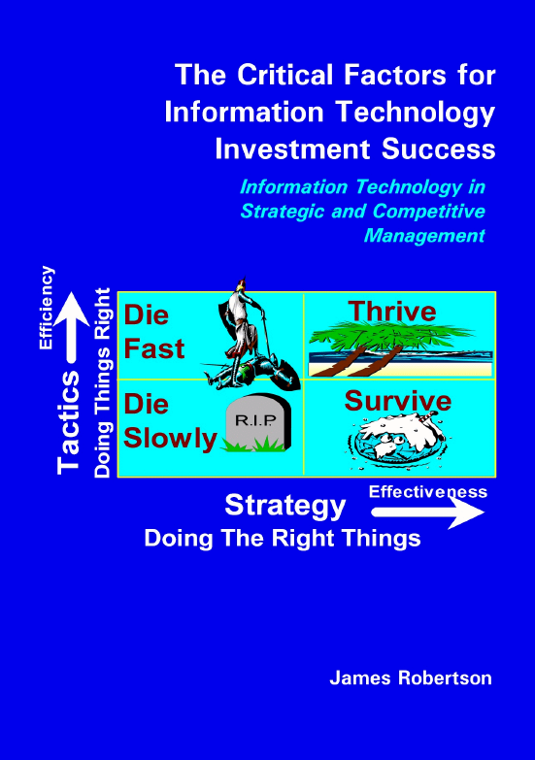
Analysis of consolidated findings
https://www.dropbox.com/sh/vfkrz5p5yliwwar/yV7SrD6kSh
Notes:
WHAT CAUSES IT FAILURE?
Since 1993, analysed in 2003, course, book
Sustainable versus experimentation
People
The factors causing IT failure – in 1993 I became aware of the high failure rate of IT projects and started to talk about it – as a consequence i was asked to investigate many failed or failing projects and to help to turn them around – over the years i built up a large catalogue of the factors causing failure – in 2003 i undertook a critical issues analysis of the factors causing failure and arrived at a list of seven critical factors causing failure together with the critical factors for success which then became the subject of a course and subsequently a book – HOLD UP THE BOOK – since then i have advised many clients and led a number of significant projects and consistently validated the basic analysis
The biggest single factor causing failure is Mythology at 30% followed by lack of executive custody and inappropriate governance at 25%

Slide 7
Factors causing ERP failure
Based on 20 years of experience conducting Pulse Measurements

Slide 8
People and technology alignment
High frustration
Performance
improvement
Empowerment
Commitment
Ownership
Experience
Knowledge
Participation
Consultation
Information
P
eople
High risk
Technology
Methods
Strategic objectives
Systems
Structures and processes
After Dr Fritz Hölscher

Slide 9
Analysis of findings at ...
Assessment of business risk
Probability of occurrence
Expected delay to occurrence
Business Outcome | Time Years |  | Probability
 | Lo | Hi | Lo | Hi
Outright business failure | 0.5 | 3.0 | 20% | 30%
Seriously detriment growth | 0.5 | 1.0 | 30% | 50%
Sub-optimal business operation | Now |  | 40% | 15%
Scrape by | Now |  | 10% | 5%
Thrive | Never |  | 0% | 0%
TOTAL |  |  | 100% | 100%
Success measured by share price and shareholder return on investment – function of growth and profitability
Notes:
DHL, Prochem,

Slide 10
Analysis of findings at ...
Conclusions
Nothing wrong with … -- work on a 20 year design life
Severe risk of fatal business damage
Huge opportunity for strategic high value implementation
Notes:
DHL, Prochem,

Slide 11
Analysis of findings at ...
Risk and opportunity
Risk
Very weak configuration and data engineering
Very weak integration
Cannot get required information
Inefficient system and business operation
e.g. Not able to manage the decline
Opportunity
Strategic top down design
The essence of the business and how we thrive
High quality data engineering and configuration
Accurately model the business
Creative features to support strategic objectives
Fix the mess and raise the bar

Slide 12
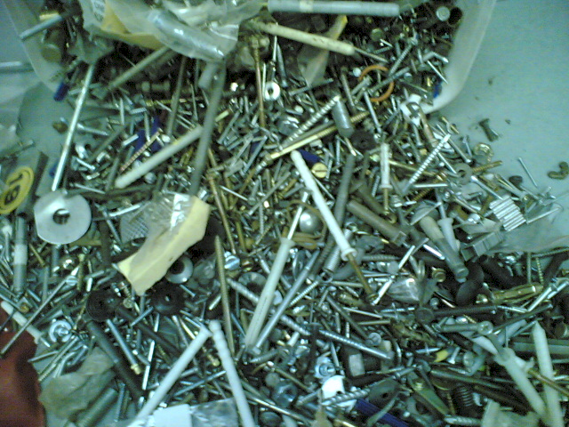
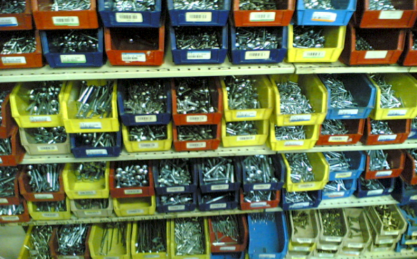
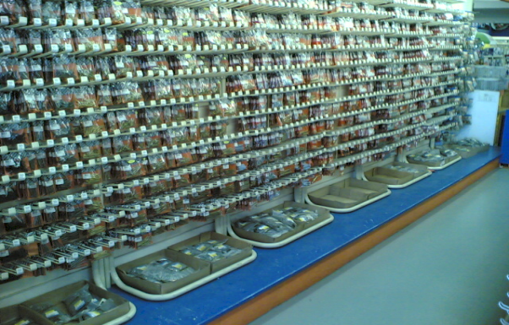
Precision versus jumbled data

Slide 13
...’s current data engineering and configuration – Chart of Accounts
EXTREMELY WEAK
Huge impact on integration, reporting, etc
500528 | Waste Material Consumed
500530 | Loss from valuation of external materials
500540 | Loss from valuation of own materials
500550 | Losses - inventory variance -consignment sale
500560 | Safety Clothing
500565 | Safety Equipment
500570 | Sand & Stone
500575 | Scraper Rope
500580 | Scrapers
500585 | Services
500590 | Signs
500595 | Skips & Cages
500600 | Finished Goods Inventory Offset
500605 | Smelting & Refining
500610 | Production Order Settlement - Variance
500615 | Steel Other
500620 | Steel Sections
500625 | Steel Sheets & Plates

Slide 14
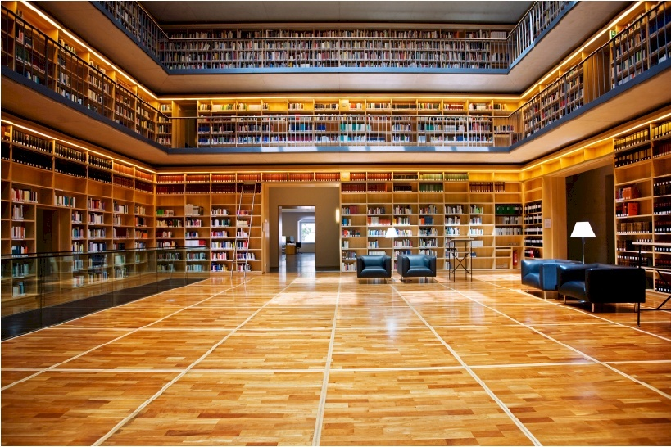
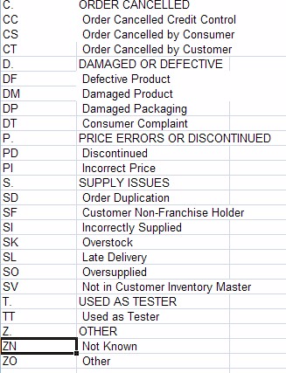
From limited information access to highly ordered access
Example of simple hierarchically structured data table

Slide 15
Structure of strategically aligned Chart of Accounts design
Tentative concept
Assets
Assets owned
Assets leased
...
Dep’n assets owned
Dep’n assets leased
...
Liabilities
Income
Expenses
R&M assets
Finance and insurance
assets
...
Plant Maintenance
Materials Management
Investment
E...
D..
... operation
Processing
Marketing and sales
Operational support
Administration
Dividends, taxes, etc
MOBILE PLANT
LHD’s
Dump trucks
Drill rigs
Other off road
LDV’s
etc
Provide for foreseeable growth – open cast ..., etc

Slide 16
Mapping between modules
Well structured
GL R&M spares expenses
MM plant spares
MOBILE PLANT
Loaders
Dump trucks
Drill rigs
Other off road
LDV’s
etc
MOBILE PLANT
Loaders
Dump trucks
Drill rigs
Other off road
LDV’s
etc
Irrespective of the level of detail there is a parallel mapping from MM to GL, may be many items in MM to one item in GL but same logic
Configuration is then easy and can be partially automated

Slide 17
Mapping between modules
Badly structured
500528 | Waste Material Consumed
500530 | Loss from valuation of external materials
500540 | Loss from valuation of own materials
500550 | Losses - inventory variance -consignment sale
500560 | Safety Clothing
500565 | Safety Equipment
500570 | Sand & Stone
500575 | Scraper Rope
500580 | Scrapers
500585 | Services
500590 | Signs
500595 | Skips & Cages
500600 | Finished Goods Inventory Offset
500605 | Smelting & Refining
500610 | Production Order Settlement - Variance
500615 | Steel Other
500620 | Steel Sections
500625 | Steel Sheets & Plates
MOBILE PLANT
Loader’s
Dump trucks
Drill rigs
Other off road
LDV’s
etc
Lack of consistency in detail in Chart of Accounts, random mapping, difficult and costly to maintain, VERY DIFFICULT to report on strategically

Slide 18
Mapping between modules
Badly structured
The spaghetti syndrome
Can continue to weave a tangled web but as the business grows this will become less and less practical and is likely to eventually block effective operation and certainly reporting
Likely to become almost impossible to extract the required information
It is impossible to add precision, logic and structure to data where there is NO precision, logic or structure

Slide 19
... Brand name ERP recommended standard chart of accounts
COST OF SALES
 | MATERIAL EXPENSE |  |  | 500000 - 509999
 |  | 500000 |  | Raw Materials - consumed
 |  | 500001 |  | Raw Material - Wastage
 |  | 500002 |  | Raw Material – Wastage 2
 |  | 500005 |  | Raw Materials - Cost of Goods Sold
 |  | 500010 |  | Raw Materials - scrapped
 |  | 500015 |  | Raw material 2 consumption
 |  | 500020 |  | Finished Goods - consumed
 |  | 500025 |  | Finished Goods - Cost of Goods Sold
 |  | 500030 |  | Finished Goods - scrapped
 |  | 500035 |  | Inv. change - sale of own goods w/o cost element
 |  | 500040 |  | Packing Materials - consumed
 |  | 500045 |  | Packing Materials - Cost of Goods Sold
 |  | 500050 |  | Packing Materials - scrapped
 |  | 500060 |  | Inventory change-cost of goods sold w/o cost elem.
 |  | 500080 |  | Spare Parts - consumed
 |  | 500085 |  | Spare Parts - Cost of Goods Sold
 |  | 500090 |  | Spare Parts - Scrapped
 |  | 500100 |  | Component Material - Consumed
 |  | 500105 |  | Comp. Parts - Cost of Goods Sold
 |  | 500110 |  | Component Materials - scrapped
 |  | 500130 |  | Manufactured Material - Consumed

Slide 20
Analysis of findings at ...
Consequences of data engineering issues
Posting inaccurate
Difficult to train new users
Engagement is poor
Inquiry and reporting cumbersome, clumsy and time consuming
Reporting and analysis is difficult
The information is there but very difficult to access
NONE of these issues in any way reflects on … the software product
Notes:
There are a very large number of other issues
The lack of structure and logic make posting inaccurate, make it difficult to train new users and make inquiry and reporting cumbersome, clumsy and time consuming
The numerous duplications of physical items in the item codes result in almost complete inability to manage and report on these items
Overall the net effect is that the information is there but it is extremely time consuming and difficult and in some cases almost impossible to quickly extract answers to management queries

Slide 21
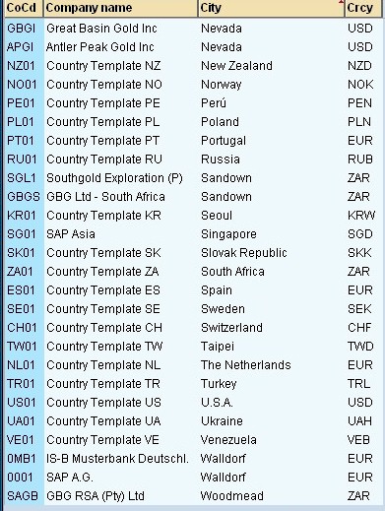
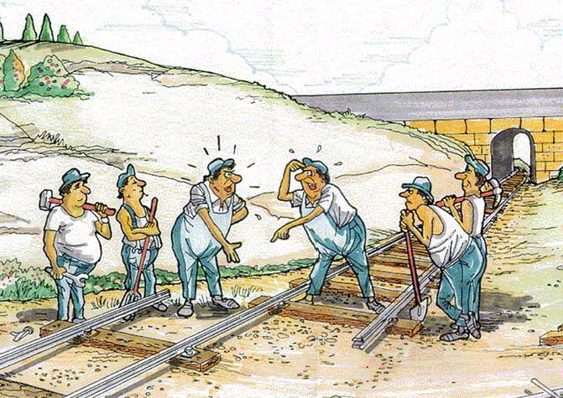
Analysis of findings at ...
The essential drivers of failure
Service provider
... management

Slide 22
Raising the bar -- opportunities to create exceptional strategic value and therefore shareholder value
High value strategic and operational management information
Strategic costing model
SPECIALIZED COMPONENTS
Shift and … level planning and costing
Precision ... modelling
Optimization of worker knowledge and experience development
Optimization of efficiency of mobile plant
...
Some custom technology in some cases

Slide 23
Longevity of the scenarios
Formal best practice data engineering
Mapping within current constrains
Notes:
Been doing for 20 years, done dozens

Slide 24
ERP people who lie

Slide 25
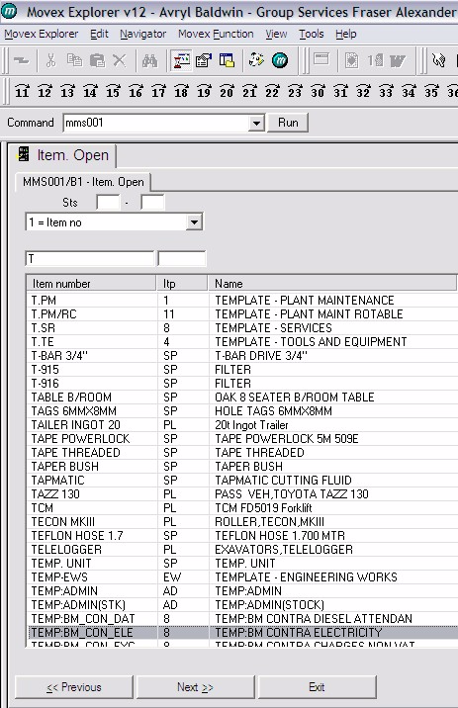
Current Issues with the … Master
Unstructured
Lack of robust disciplined code management
Different blocks of codes for different divisions
Same item in more than one place
Different categories should be in distinctly separate logical blocks
Notes:
Unstructured –e.g. tape adjacent to Excavator, lack of robust disciplined code management
Different blocks of codes for different divisions – same item occurs in more than one place
Different categories of item should be located in distinct code components from a business analysis and management perspective – services should not be adjacent to excavators and tables

Slide 26
Current Issues with the … Master
Equivalent descriptions different codes
Warehouse codes embedded in item codes
As many as twenty occurrences of the same physical
Makes operation and reporting inaccurate and difficult
Notes:
Apparently equivalent descriptions with different coding
Warehouse codes embedded in item codes resulting in one stock item occurring multiple times – the software can do the required analysis without this
There are instances with as many as twenty occurrences of the same physical item with different codes – Avryl to find example
FAILURE OF THE PLANT MAINTENANCE SYSTEM IS PROBABLY ATTRIBUTABLE TO THIS TYPE OF DATA ISSUE

Slide 27
Current Issues with the … Master
Multiple occurrences of the same physical entity with different codes
Very different codes for broadly identical physical entities – tyres – locate in entirely different locations in the table
Notes:
These anomalies make it time consuming and cumbersome to produce reports and make the production of sophisticated reports almost impossible
Have contributed materially to difficulty of developing effective solutions with Board MIT

Slide 28
Consequences of these Issues with the … Master
Large number of other issues
Posting inaccurate
Difficult to train new users
Inquiry and reporting cumbersome, clumsy and time consuming
Duplications hinder and prevent reporting and analysis
The information is there but very difficult to access
Notes:
There are a very large number of other issues
The lack of structure and logic make posting inaccurate, make it difficult to train new users and make inquiry and reporting cumbersome, clumsy and time consuming
The numerous duplications of physical items in the item codes result in almost complete inability to manage and report on these items
Overall the net effect is that the information is there but it is extremely time consuming and difficult and in some cases almost impossible to quickly extract answers to management queries

Slide 29
Consequences of these Issues with the … Master and other master files
All of these issues relate to the data content
NONE of these issues in any way reflects on …
If we loaded this same data into any other software we would have the same experience
Varying degrees in other master files
All coding to be overhauled as will be done for item master
Notes:
All of these issues relate to the data content
NONE of these issues in any way reflects on Movex
If we loaded this same data into any other software we would have the same experience
These issues occur to varying degrees in other master files -- all coding will be overhauled in accordance with the approach described for the item master

Slide 30
Fixing E.R.P. problems
A general principle
“If you do what you have always done you will get what you always got”
Radical and effective NEW approach and action is called for
Notes:
Been doing for 20 years, done dozens

Slide 31
Questions?
Dr James Robertson PrEng
James A Robertson & Associates
Telephone: ++27-(0)86-111-5409 / ++27-11- 782-5996/7
Cell: 083-251-6644 (preferred)
Fax: ++27-(0)86-540-0178
P O Box 4206, Randburg, 2125, South Africa
www.JamesARobertson.com
email: James@JamesARobertson.com
Please remember to complete the evaluation forms
Finding the missing pieces of your I.T. and strategy puzzles

